Slide 1
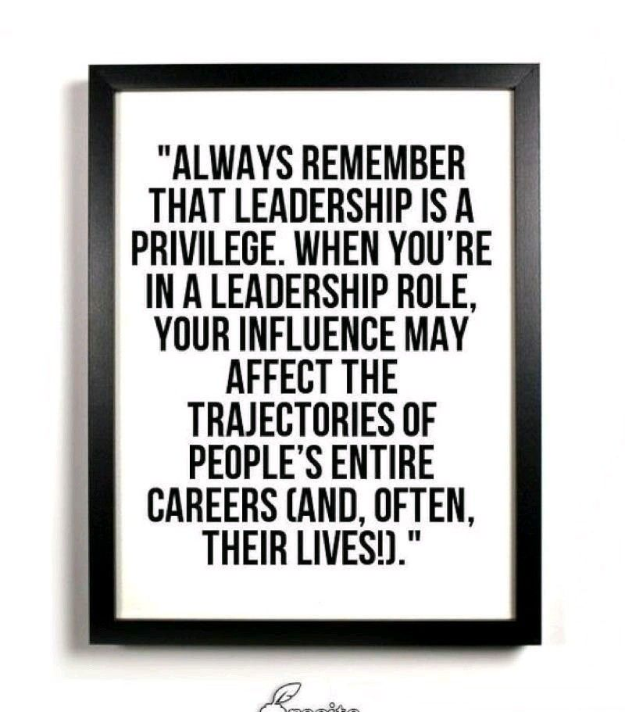
CSE 170 Technical Teamwork Leadership

Slide 2
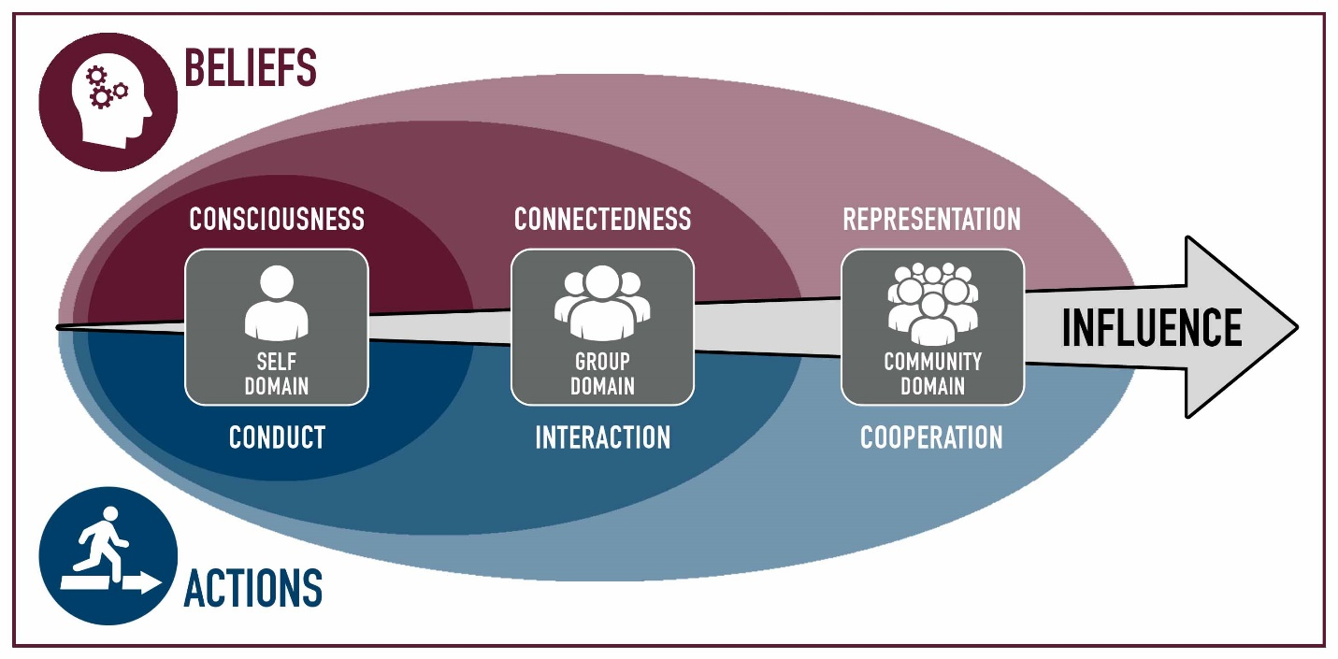
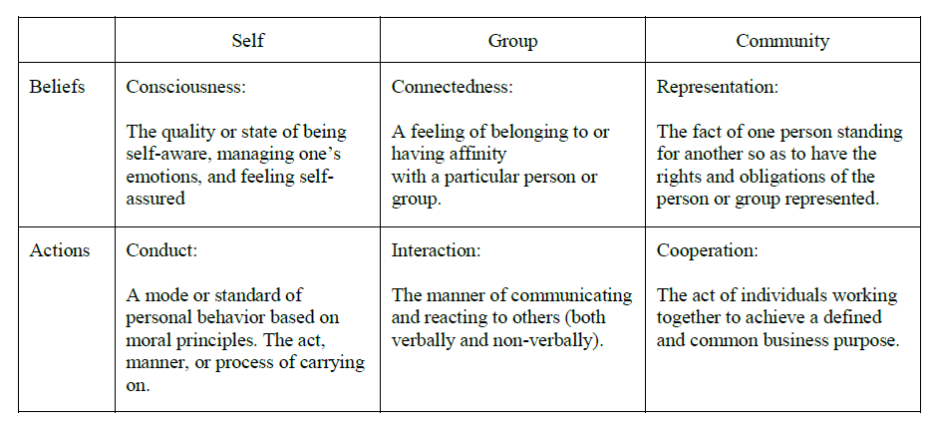
Commitment, Estimation, Stewardship
 | Module | Domain | Competency
1 | Teamwork
2 | Influence
3 | Personality | Self | Consciousness
4 | Motivation | Self | Consciousness
5 | Professionalism | Self | Conduct
6 | Pressure | Self | Conduct
7 | Commitment | Group | Connectedness
8 | Conflict | Group | Connectedness
9 | Integrity, Trust & Honesty | Group | Interaction
10 | Communication | Group | Interaction
11 | Leadership | Community | Representation
12 | Loyalty | Community | Representation
13 | Cooperation | Community | Cooperation
14 | Synergism | Community | Cooperation

Slide 3
Leadership
Do you remember X and Y Theory?
What is a Manager?
What is a Leader?
What characteristics, soft skills, etc does a leader practice?

Slide 4
Leadership the Lord’s Way
Read 5 minutes
What is leadership?
What are the qualities of leadership?
Why do we have callings?
Leadership does not require a calling
Leadership is not telling people what to do
Exert and Uplift
Leading the way

Slide 5
The Four Points of Practical Leadership Empowering Other
There is no single "right way“ to empower others
Lend a helping hand
Facilitate accomplishments to the extent possible
Acknowledge others’ abilities
Tools:
Information
Resources
Support
Connect to Outcomes
Positive Emotions

Slide 6
Leadership with a Small “L”
It is leadership with a small “L”—the kind of leadership that builds and lifts and inspires through kindness and love and unselfish devotion to the Lord and His work.
Principle #1: Lead by Example
Principle #2: Lead with Vision
Principle #3: Lead with Love

Slide 7
Two Fast Ways To Show Your Company That You Have Great Leadership Skills (Even If You Don’t Have A Leadership Title)
not enough alignment between leaders' visions and the organization's vision
"is what we're planning consistent with where the company's trying to go right now?“
when employees feel like their suggestions are being received, they're a lot more motivated
"I was talking to Sally the other day, and she had a great idea for how we could process more orders… Sally, I don't want to put you on the spot, but would you be willing to share your idea?"
Not herding – no vision/alignment
Not recognized – no motivation

Slide 8
Lollop-pop Experiences
Everyday Leadership https://www.ted.com/talks/drew_dudley_everyday_leadership?language=en
Taking credit and feeling good about
We can expect
Don’t make leadership bigger than yourself.
Change the capability, agent for change

Slide 9
Lollop-pop Experiences
Everyday Leadership https://www.ted.com/talks/drew_dudley_everyday_leadership?language=en
What is a leader?
How do I become a leader?

Slide 10
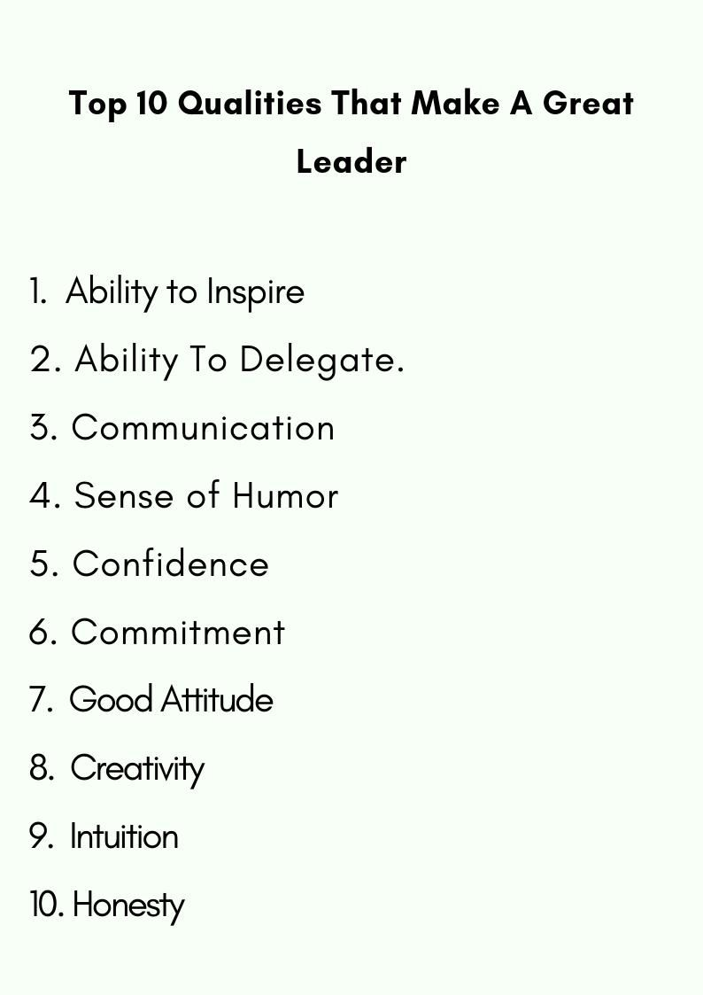

Slide 12

Faye Navarro (Part A)
Faye’s Background
SW Engr,
Calm and measured
QA manager
Terrence Background
Unrelenting for safety
Extreme urgency
Sister died in accident
His startup just got purchased
Conflict
“Safe-life perspective” – ok with bugs, replace before chance of error – sensor detect it – software needed – passed software crashed
New code – not tested
Training: best practices like branching the code, merging the changes, and working with quality assurance to test it
Terrence wanted new software installed sooner
Faye wanted it tested.

Slide 13

Faye Navarro (Part A)
Terrence open the meeting. “Quality is important at Sherwin,” he said. “That’s why we’ve taken great care to make sure it’s working. In fact, it really doesn’t need tested at all.”
Faye installed the software on a nearby computer and started it up. It crashed immediately.
Terrence seemed to lose his composure almost at once, “I told you it didn’t need tested!” Adopting the most innocent tone she could, Faye replied, “we just wanted to see how it worked.”
Software patch now passed 80% of their tests
Terrence looked at Faye and raised his voice again, “If you’d stop finding defects, we could install it! We can stop these accidents from happening, right now!”

Slide 14

Parting Questions
What is the belief perspective of Terrence Baird?
When dealing with highly spoken individuals, what type of Conduct (Professionalism and Pressure) and Interactions (Ethics and Communication) influence is required?
Respected, Leader, Manager
What is the belief perspective of Faye Navarro?
What Should Faye Do?:

Slide 15
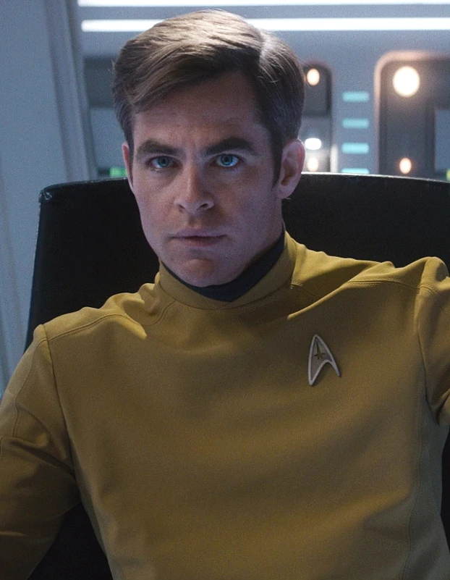
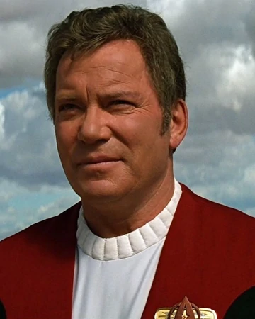
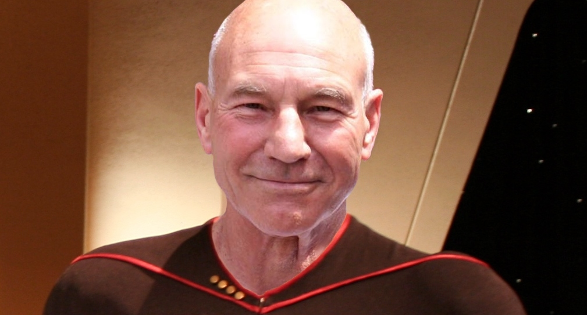
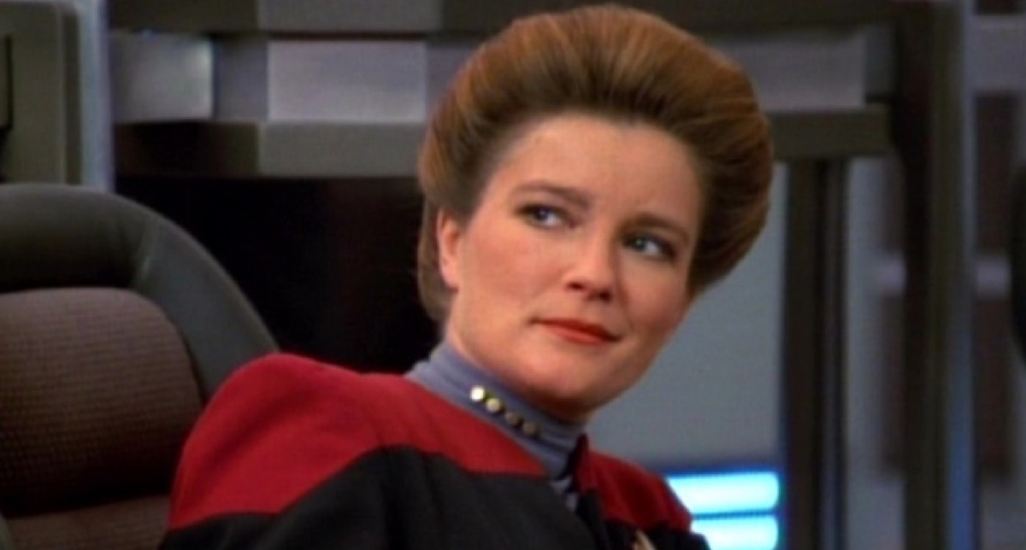
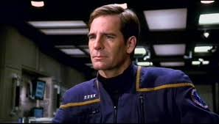
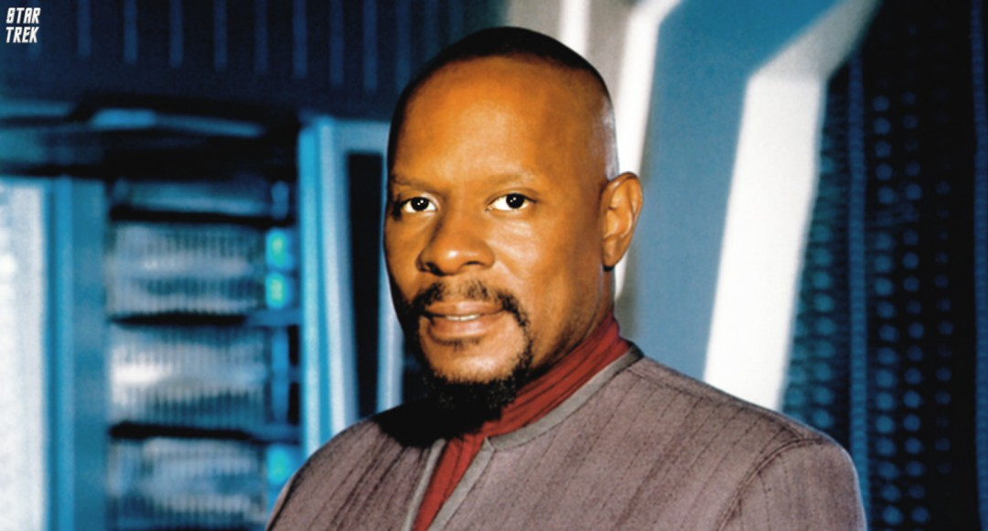
Leadership and Star Trek

